Slide 1

Notes:
11/17/16
1
1

Slide 2
BestBytes TEAM
Walter Xia Ryan Fuller Eric Kramer Abderrahman Said-Alaoui Santiago Munevar
Notes:
11/17/16
2
2

Slide 3
What is it??
A Trump meme generator?
Notes:
11/17/16
3
3

Slide 4
Notes:
11/17/16
4
4

Slide 5
Website and database
Since somebody took music immediately
Topic News
Pillars Articles | Sources | Locations
Notes:
11/17/16
5
5

Slide 6

Notes:
11/17/16
6
6

Slide 7
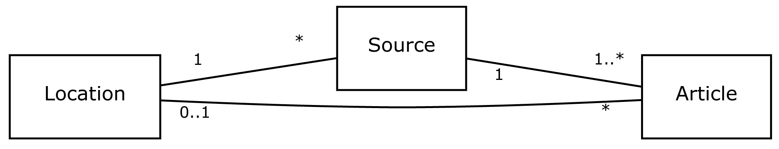
uml
Notes:
11/17/16
7
7

Slide 8
Pillars attributes
Articles
Title
Description
Source
Publication Date
Category
Region
Sources
Logo
Name
Country
Language
Description
Locations
Country
Region
Currency
Lat/Long
Capital
Population
Notes:
11/17/16
8
8

Slide 9

Notes:
11/17/16
9
9

Slide 10
Data scraping
api.newslookup.com
newsapi.org
Titles, descriptions, sources, categories, published dates, images, external links to article and source, region
restcountries.eu
Country specifics: language, currency, location data
Notes:
11/17/16
10
10

Slide 11
Critiques BestBytes
We are great!
We had a hard time finding a topic, someone took Music
Scraping pure HTML is horrible and we avoided it
Fat cats that can't wipe their butt and trump randomly appear on the front page, great success!
Notes:
11/17/16
11
11

Slide 12
Critiques VGCIDB
It was a great idea!
Where are platforms in the game table?
Hard time pulling individual large images
It was insanely comprehensive, what is the 3DO?
Notes:
11/17/16
12
12

Slide 13
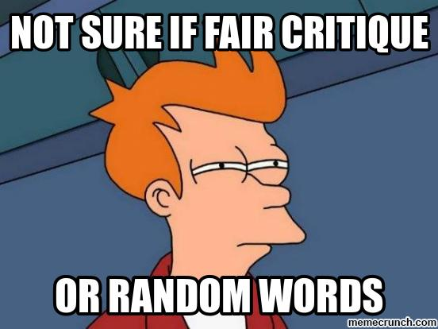
Notes:
11/17/16
13
13

Slide 14
Issues 45 closed | 1 open
Opened
Eric: 35
Ryan: 7
Santiago: 0
Said: 2
Walter: 2
Closed
Eric: 39
Ryan: 4
Santiago: 1
Said: 1
Walter: 2
Notes:
11/17/16
14
14

Slide 15

Notes:
11/17/16
15
15

Slide 16

Unit tests
Run them.
Notes:
11/17/16
16
16

